Slide 1


Using with
By Raul Maldonado
PyBay 2018, Lightning Talk: @Cloud_Chaoszero

Slide 2
Motivations
You are creating a web framework using Flask to present some data findings through either visualizations, tables, or some other data related operation.
You would like to work with a database. However, there is no pre-built Object Relational Mapping (ORM) with Flask...
To resolve our pain-points, we use SQLAlchemy.
PyBay 2018, Lightning Talk: @Cloud_Chaoszero
Notes:
Flask VS Django

Slide 3
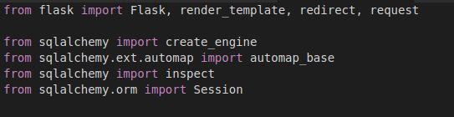
This is Not...
a Flask-SQLAlchemy module overview, but for both Flask and SQLAlchemy
In-depth of technical analysis and discussion of both modules
Complex application to present data to web framework. Only a “Lightweight” application. See here**
PyBay 2018, Lightning Talk: @Cloud_Chaoszero
Notes:
Flask-SQLAlchemy Documentation
SQLAlchemy Documentation
Flask Documentation
** If link not running, please run yt-Application.py file by running “python yt-Application.py”

Slide 4
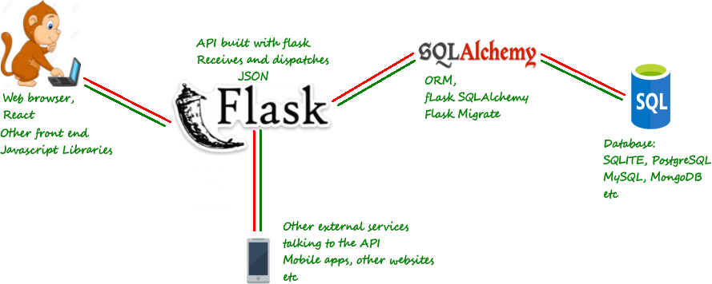
Combining Flask and SQLAlchemy
Image by Daniel Osaetin
PyBay 2018, Lightning Talk: @Cloud_Chaoszero
Notes:
Flask and SQlAlchemy Overview by Daniel Osaetin

Slide 5
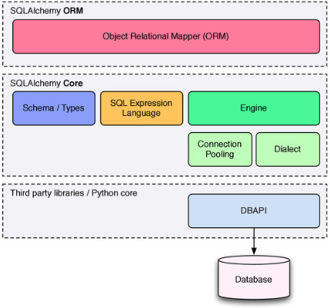
SQLAlchemy
SQLAlchemy is a popular ORM SQL toolkit for database manipulation
Use with web frameworks to support SQL-like queries from an Object Oriented perspective with either CORE or ORM options
Benefits:
Security
Convenience
DRY principle
Persistence
Performance
And more! (e.g. Start being one of the cool kids)
Image by SQLAlchemy website
PyBay 2018, Lightning Talk: @Cloud_Chaoszero
Notes:
SQLALchemy over Raw Database

Slide 6
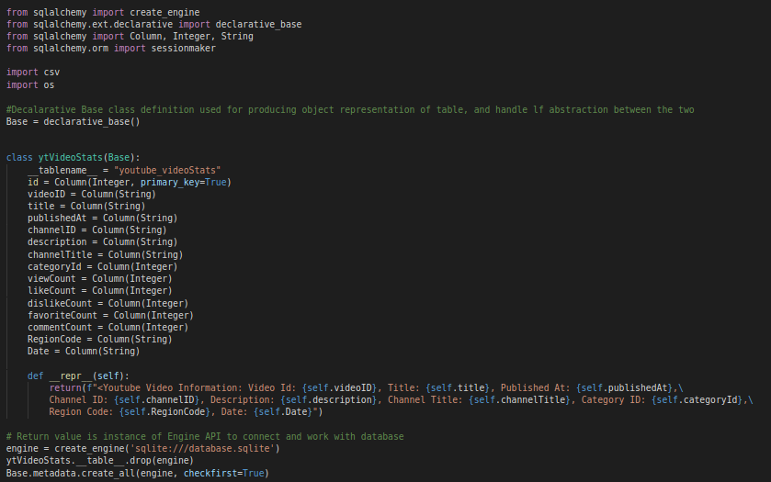
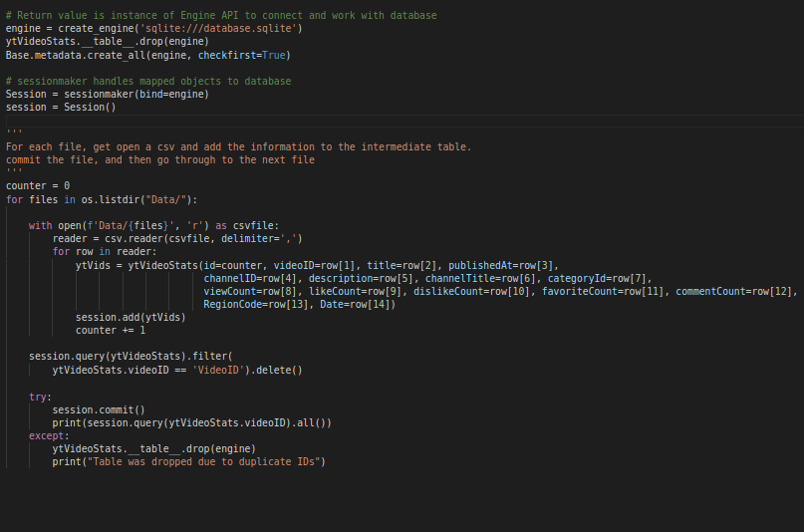

Slide 7
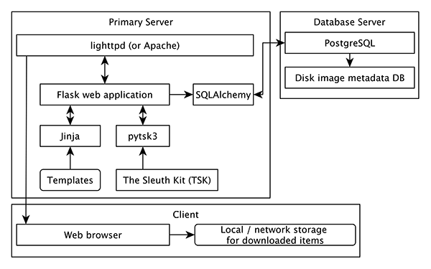
Flask
Popular lightweight/minimalist Python web framework
Not developed based on “Batteries-included Approach”
Micro but extensible web framework by customization of open and compatible tools and libraries
Developer friendly because of the minimal framework + added features approach
Micro: “Keep core simple but extensible”
Can have option to add database layer, form validation, upload handling, or other framework-like tools
Image by Code{4}Lib
PyBay 2018, Lightning Talk: @Cloud_Chaoszero
Notes:
Flask vs Django
Code4Lib on Web Service for Local file access

Slide 8
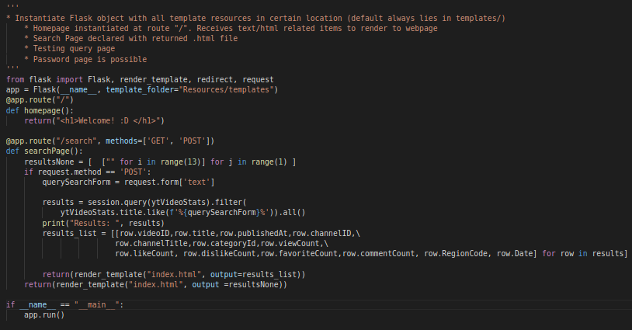

Slide 9
Thank you
Github Repo: http://bit.ly/sqlalch-flask-pybay2018

